Slide 1
Légion d’Honneur and French Consulate scholarship 2025

Slide 3
https://www.qualitefle.fr/rechercher-un-centre
MUST BE LINKED TO A UNIVERSITY TO TRANSFER CREDITS

Slide 4
Guidelines for summer studies scholarships

Slide 5
Application
1) Complete the online registration for the study programme you chose through their website and process the necessary payment (tuition fees, accommodation fees, etc.) on your own. For inquiries, you should directly contact the host universities.

Slide 6
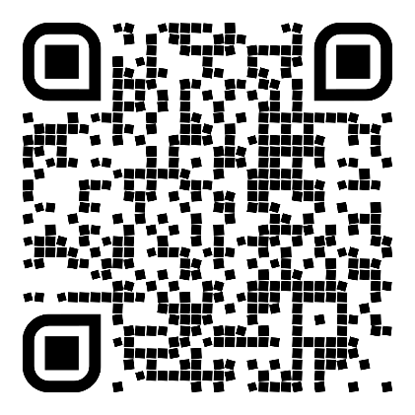
Application
2) Submit the Linguistics &
Modern Languages
online registration form
through the following
website between
1 and 31 March
Department of Linguistics and Modern Languages - Overseas Summer Study Programme of Modern Languages 2025 - Financial Support Application Form
- Your unofficial transcript downloadable from CUSIS will be required for the online registration.

Slide 7
Selection Criteria
1) Number of French courses you took.
2) The cumulative GPA of these French courses.
3) Your overall cumulative GPA.

Slide 8
For the recepients of the scholarship
You will be notified via email and be reimbursed after the completion of your study trips (in January this year). You are required to report to LIN Department if you receive any other CUHK funding support for your trips (not possible to cumulate some of them).
Commitment Form: upon your selection, submit a “commitment form” to the consulate, before Sunday 18 May 2025.

Slide 9
For the Recipients of the Scholarship
Upon the completion of your summer course in France:
1) you must submit copies of your certificate of attendance and/or academic reports together with the original copies of the payment receipts of the air tickets, tuition fees and accommodation fees for reimbursing the sponsorship.
2) You also must submit a written report of 500-800 words in English on their overseas learning experience, together with 10 photos taken during the study trip. LIN Department will have the right to publish and use them for promotion.
3) You must attend the “French Scholarships Award Ceremony”, at the French Consul’s residence, usually in November/December. If you are in Hong Kong, your presence is compulsory.

Slide 10
Document from LIN Department
Overseas Summer Programme Notes:
OverseasSummerProgNotes2025.pdf

