Slide 1
Paris

Slide 2
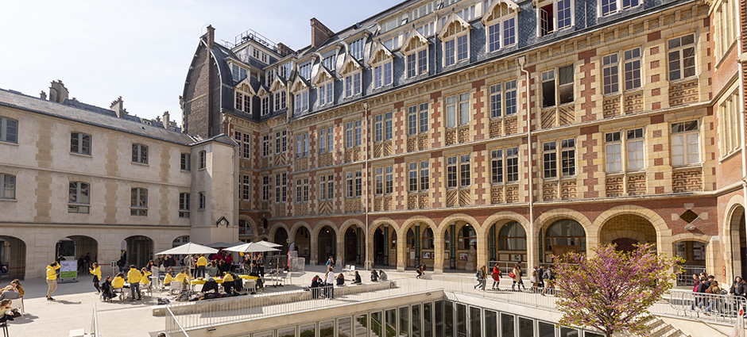
L’ILCF de Paris

Slide 3
Total course fee for a 4-week course | - 1134€ (1260€ -10%), 21h/per week, 84 hours in total. + Enrollment fee: 100€
 | Course only
Accommodation | Host families with Stay and Studies: https://www.staystudy.fr/PRICES - Room only 31€ per night (36,8€ with breakfast included) + 5% for a stay of less than 6 weeks, so around 813€ for 25 nights.
Dates | - 2 to 27 June - 1st 25 July. - 4 to 29th August.
Link | https://ilcf.icp.fr/en
Enrollment | Before May 16.

Slide 4
“A walk about Paris will provide lessons in history, beauty, and in the point of Life.”
Thomas Jefferson

