Slide 1
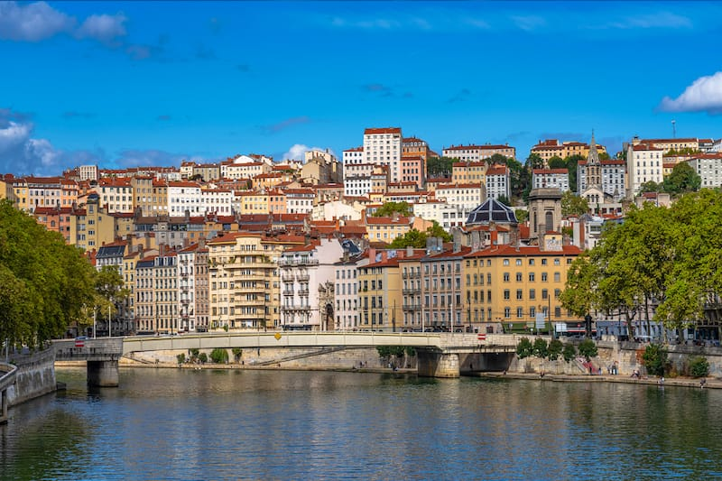
2025 France Summer Programme
LYON

Slide 2
Programme in ILCF, in Lyon.

Slide 3
Lyon, une ville où il fait bon vivre Lyon, a city famous for its art of fine living
©Jacques Léone/ Grand Lyon

Slide 4
Lyon, une ville où il fait bon vivre Lyon, a city famous for its art of fine living
The Rhône river

Slide 5
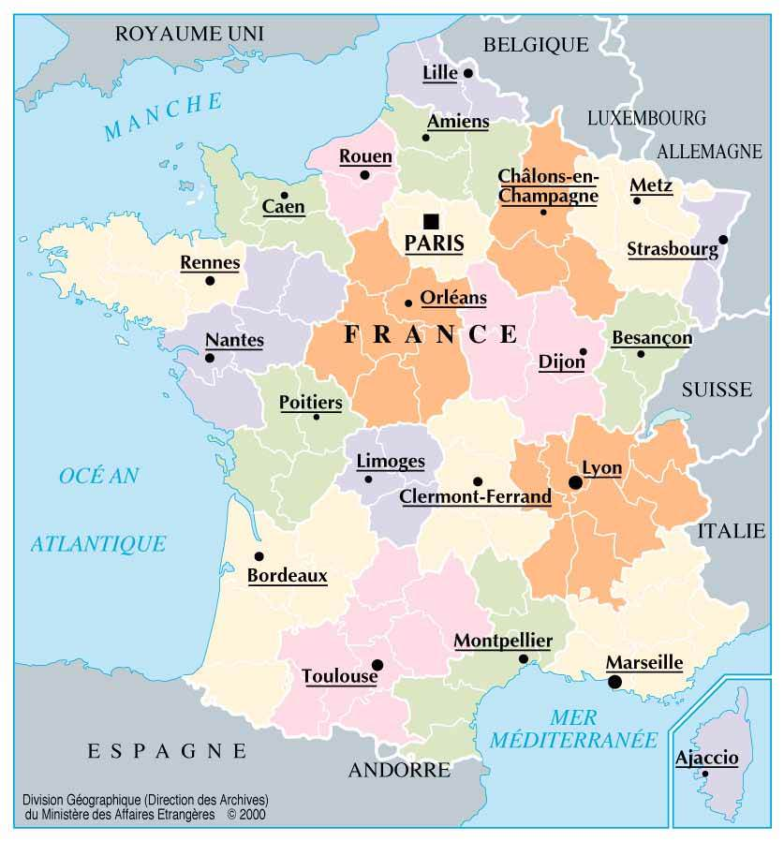
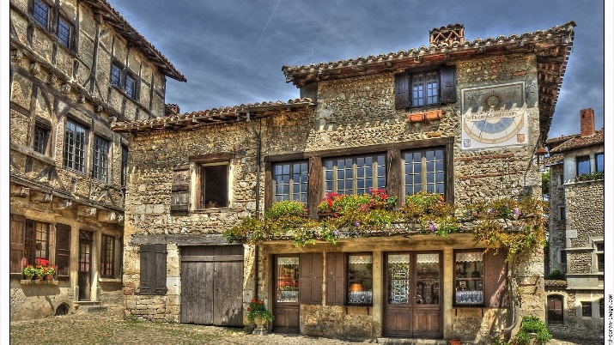
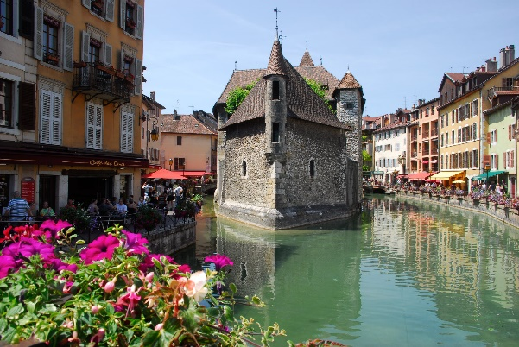
Around Lyon
Pérouge – A medieval town
Auvergne – A volcanic area
©Jacques Léone/ Grand Lyon
Annecy – The Venice of the Alps

Slide 6
Founded in 1948 in the very heart of Lyon, a major European capital, the French Language and Culture Institute (ILCF Lyon) provides courses in French as a Foreign Language (FLE). It is a member-institute of UCLy's Faculty of Literature and Languages.

Slide 7
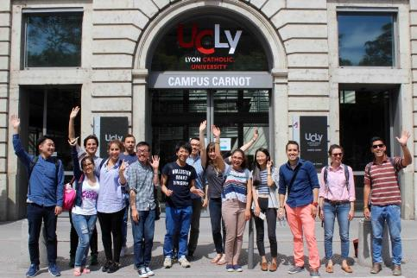
Receives 2000 students per year from all 5 continents. Being a student at the ILCF will give you the opportunity of meeting other people, of living together in an intercultural environment.

Slide 8
Link : Summer intensive french courses: July, August and September - ILCF - Institut de Langue et de Culture Françaises

Slide 10
Total course fee for a 4-week course | - 898 € (public price: 993 euros. -Mandatory UCLY third party liability insurance: 13 euros Total: 868€ (down payment 200€) (19 contact course hours per week, 76 hours in total) Textbook: 35€
 | Course + cultural activities
Accommodation | Different options available. Contact: Ms. Isabelle Morales and Valérie Mazoyer. Phone: 00-33(0)4 72 32 51 73. Email: sl@univ-catholyon.fr Websites: Accommodation office: Accommodation - UCLy Maison Saint-Bernard (MSB) Maison Saint Bernard - Maison des étudiants (maisondesetudiantslyon.fr) : 609€ + 50€ enrol. Fee + 400€ deposit (refundable at the end of your stay). MSB Booking contact: mailto:inscription@mde-lyon.fr

Slide 11
Dates | - 2 to 29 July - 4 to 29 August
Link | Summer intensive french courses: July, August and September - UCLy
Enrollment | Catholic University of Lyon online pre-registration site (ucly.fr) For July programme, enrol before April 1 2025. For August programme, enrol before May 2 2025.
80 hours of French courses, in the morning
(July or August)
4 excursions of Lyon and surroundings

Slide 12
Enrolment & payment
Reserve and pay directly on their site :
1st installment :(200 down payment online + accommodation) (not refundable)
2nd installment : 668 euros in Lyon
Once the 1st installment is paid, you cannot claim the money back.

Slide 13
Enrolment & payment
ILCF site (courses): on the enrolment page, choose “July-CUHK” or “August-CUHK”.
https://inscriptions.ucly.fr/index.php?orga=LCF&choix_langue=FR
Saint-Bernard residence (accomodation) :
1. Fill in a request here :Welcome to our booking interface - Portail de reservation (ucly.fr)
2. After confirmation, you will be given a personal resident account, accessible here : mde.ucly.fr/login
Follow the online instructions and drop the required documents in “my documents”.

