Slide 1
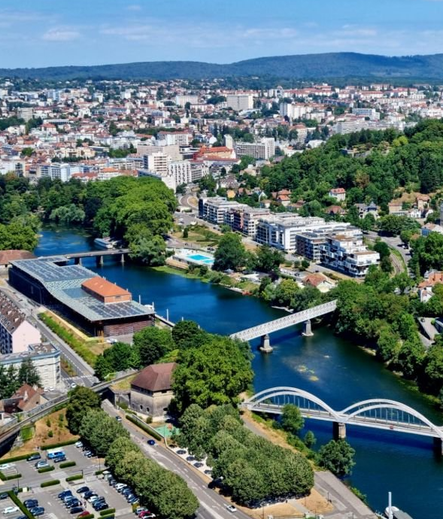
Besançon, france
2024-25 FRANCE SUMMER PROGRAMMES: C.L.A. in BESANÇON
Summer STUDY programme in France 2025; Le Centre de Linguistique Appliquée (C.L.A.) de Besançon, université de franche-comté, France.

Slide 2
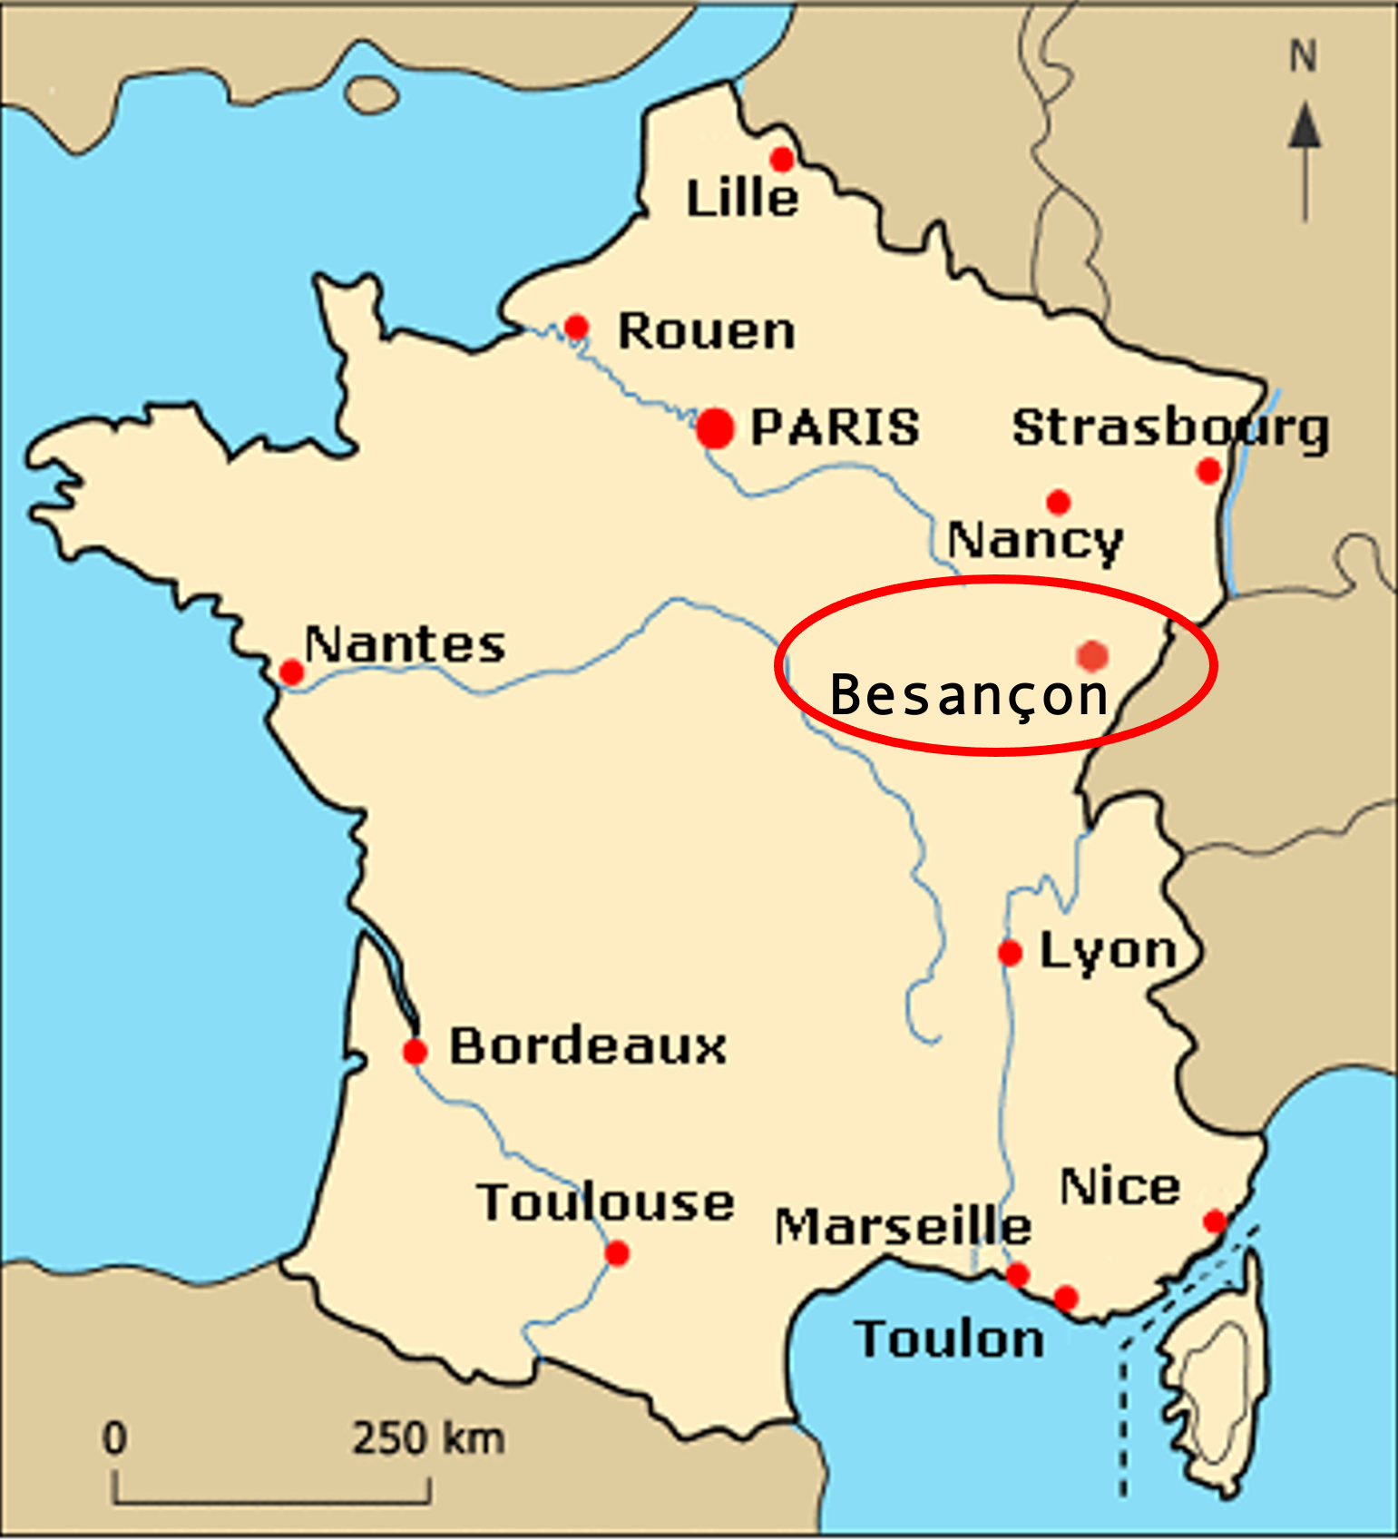
Besançon, france
North-East quarter of France
325km from Paris
250km from Lyon
Less than 100km from Switzerland
At the edge of the Jura mountains

Slide 3
Besançon [bəzãsõ]

Slide 4
Besançon : the old city and the Doubs river

Slide 5
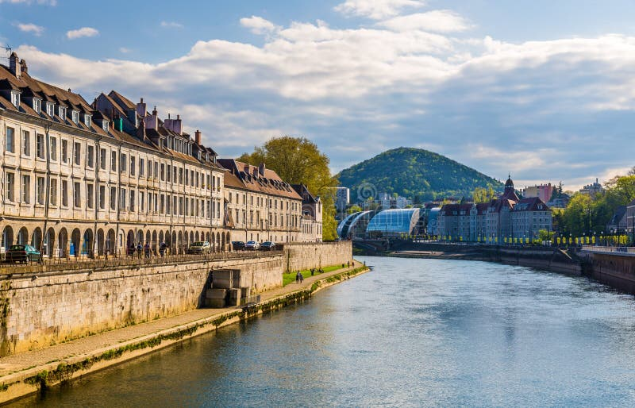
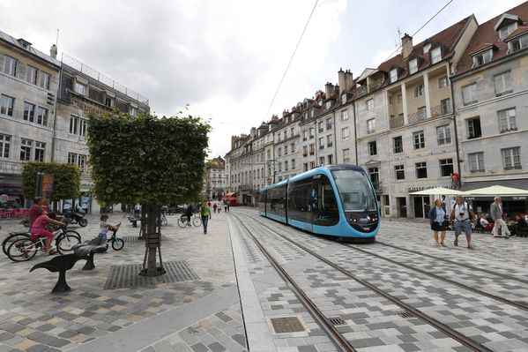
Views of Besançon

Slide 6
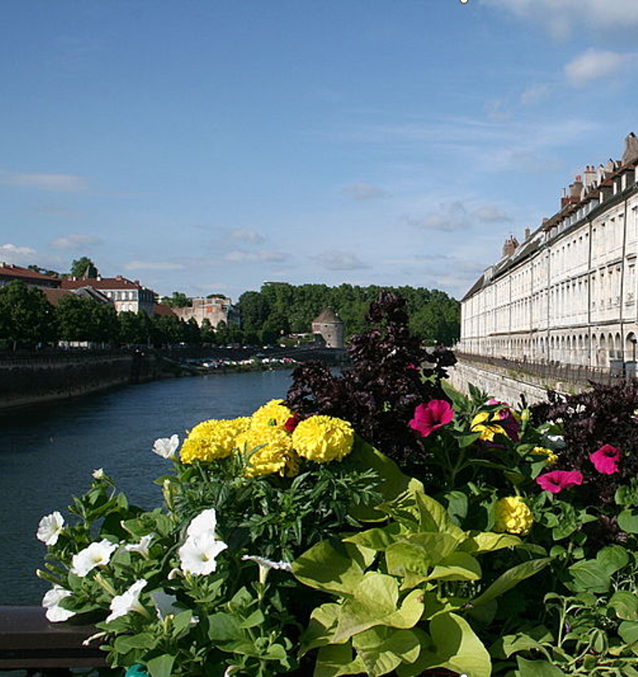
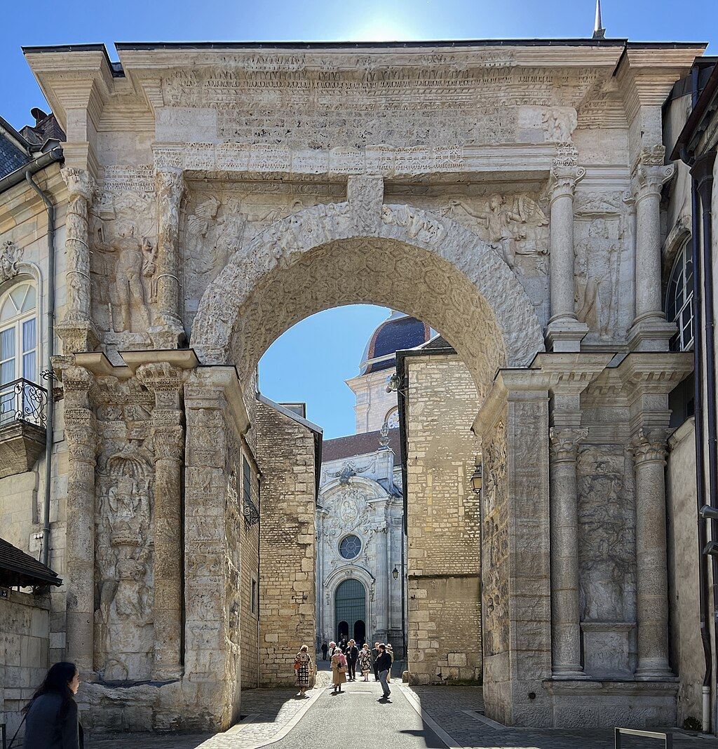
The Doubs river and the Quai Vauban.
La Porte Noire, Roman triumphal arch.

Slide 7
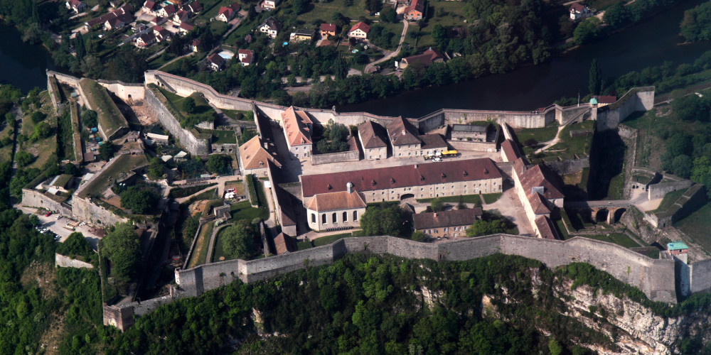
Besançon's Vauban citadel (1668 AD), a fortress listed as a UNESCO World Heritage Site since 2008.

Slide 8
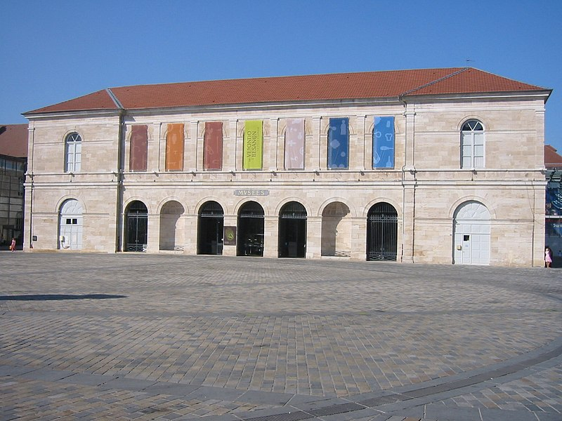
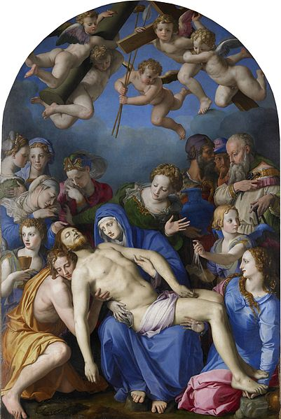
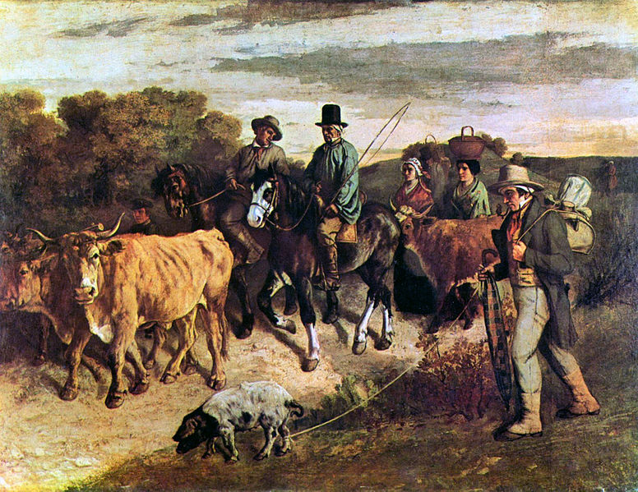
Museum of Fine Arts and Archeology.

Slide 9
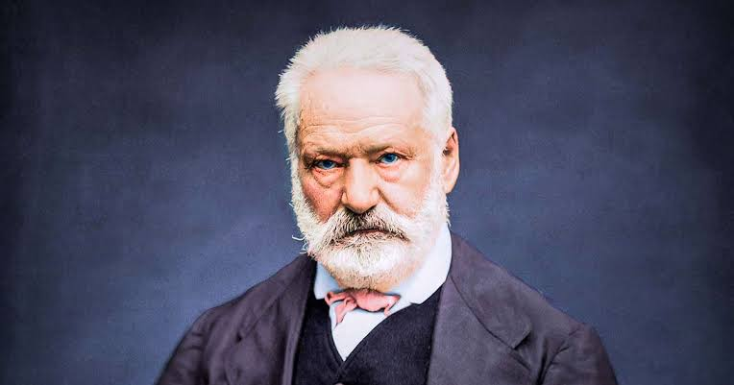
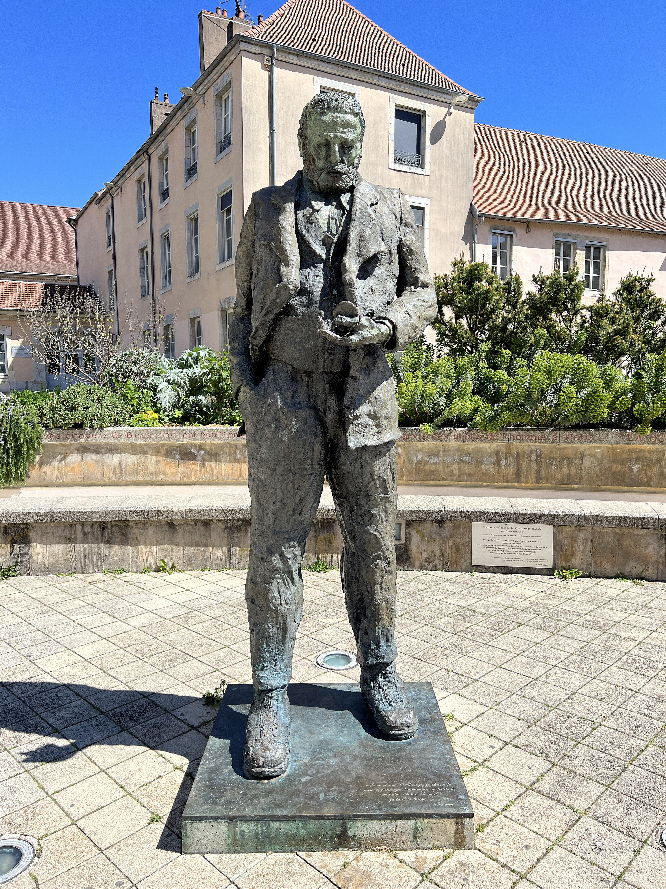
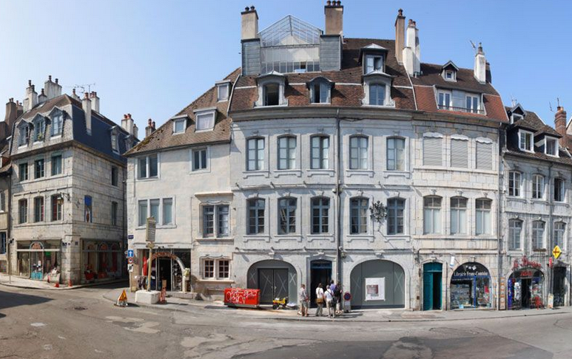
Victor Hugo, the author of Les Misérables, hails from Besançon.
His birth home, in Besançon
His statue

Slide 10
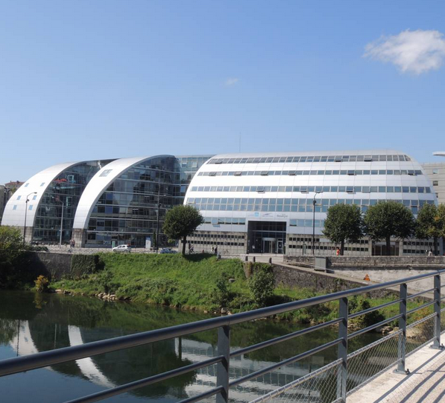
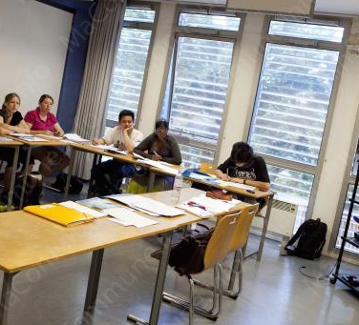
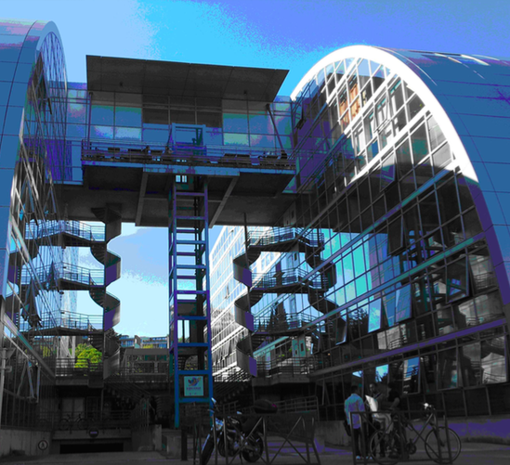
Le Centre de Linguistique Appliquée (C.L.A.) de Besançon. Université de franche-comté
Contact by email:
fle-cla@univ-fcomte.fr
Contact by phone: +(33)381665200
Contact by mail:
Centre de Linguistique Appliquée,
6 rue Gabriel Plançon 25000 Besançon, France
Website: https://cla.univ-fcomte.fr

Slide 11
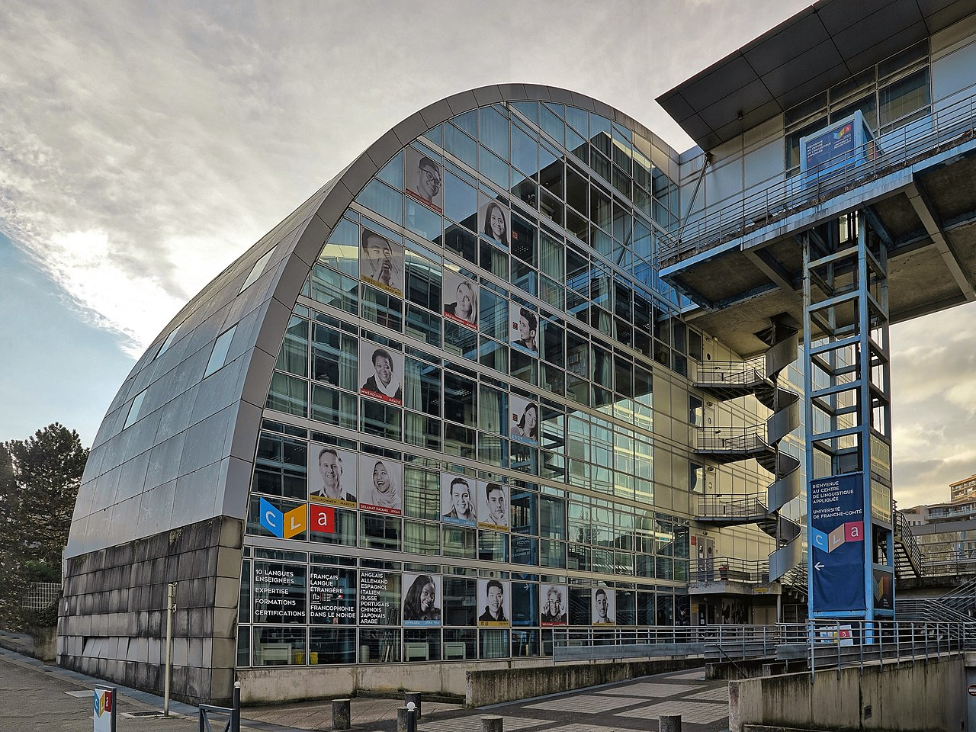
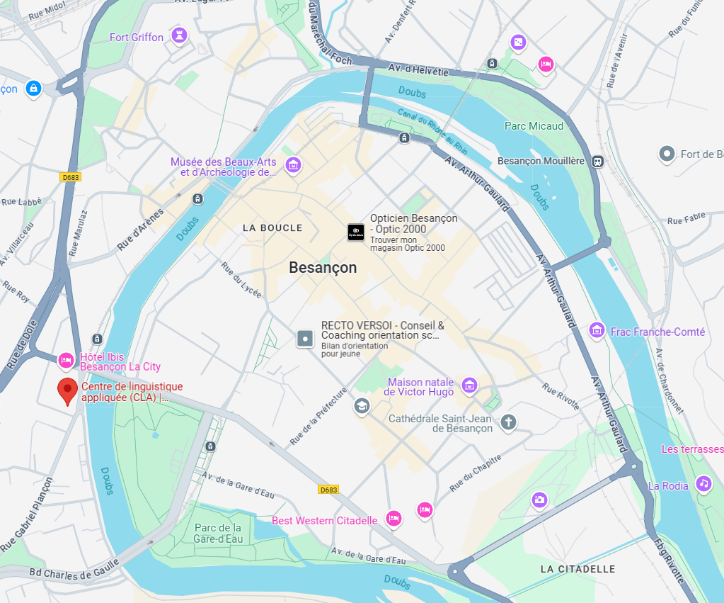
The CLA is right by the Doubs river bank, a10’-walk away from the city center.

Slide 12
Programme
Price
Enrolment & payment

Slide 13
Programme
Price
Enrolment & payment

Slide 14
Programme
88 hours of French courses per session
Sessions in June, July or August
Four-week program, including courses and outings
3 periods:
2nd – 27th June 2025
^{7th} July – 1st August 2025
^{4th} - 29th August 2025
CLA Website: http://cla.univ-fcomte.fr/french-and-language-culture/
Pedagogical coordinator : Mme Natalie PERSONENI, nathalie.personeni@univ-fcomte.fr

Slide 15
Programme
Price
Enrolment & payment

Slide 16
Price - Courses
Course Fees:
1164€ (2nd – 27th June 2025)
1164€ (7th July – 1st August 2025)
1164€ (04th - 28th August 2025)
All 3 sessions:
4 weeks, 88 hours of classes in total, 5 days a week.
No registration fee. This price includes the course + textbook and workbook + outings. The payment is done via an internet payment link.
The full fee is payable at once (refundable*).
*refunded upon presentation of acceptable proof (health issue, visa refusal etc.)

Slide 17
Price - Courses
Extra activities to be packaged:
Outings will be offered each week
and registration is possible
with the cultural service of CLA.
For all information and payment of tuition fees, please contact the tuition fee secretary:
Mme FULER Angélique,angelique.fuler@univ-fcomte.fr
Intensive French Language Course Offering:
https://gocuhk-my.sharepoint.com/:b:/g/personal/benjamin_gaudet_cuhk_edu_hk/Ee7OUWxJOT9Lps5rJo2Xqi4BpiLra5OzlxXRzgw6QLq_iw?e=UJ1Njl
Presentation of the CLA in Chinese: CLA_Chinese_Presentation.pdf

Slide 18
Price - Accomodation
Accommodation Fees:
Confirmation of your registration at the CLA of Besançon doesn’t automatically provide you with accommodation.
Any housing request should be done while enrolling in one of the training courses featuring in the online catalogue.
! IF YOU ARE PLANNING TO GO IN JULY 2025, NOTE THAT A SPECIAL PROFESSIONAL EVENT WILL TAKE PLACE THERE AT THAT TIME. IN ORDER TO GET AN ACCOMODATION, YOU MUST PLAN EARLY!

Slide 19
Price - Accomodation
For a one-month registration,
the stay being 27 nights
(from Sunday before the start of the course
to Saturday after the end of the course):
with a host family: 27 nights x €29 = €783/person
(+ 8% management fee for a quote with the CLA) individual room, with breakfast and evening meal during the week and full board on weekends. The request has to be done ASAP because of the necessity of contacting the families.
You have to fill up the Application for Host Family in Besançon: Application for Host Family Accommodation 2025.pdf

Slide 20
Price - Accomodation
For one month in a university residence
(around €450/person, Final price TBC)
+ optional breakfasts on working days around €70
(price and possibility to be yet confirmed).
The application has to be made end of May 2025.
Document on lodging in Besançon: Lodging_in_Besançon_2025.pdf
CLA accommodation webpage : Accommodation - Centre de linguistique appliquée

Slide 21
Price - Accomodation
For any information needed on accommodation
and for more information,
please contact directly Mme. Maryline SAVONET: maryline.savonet@univ-fcomte.fr
Please check here about the possibilities of accommodation: https://cla.univ-fcomte.fr/logement/famille-daccueil/

Slide 22
Programme
Price
Enrolment & payment

Slide 23
Enrolment & Payment
You Must enrol both with the CLA in Besançon AND the Linguistics and Modern Languages Department!

Slide 24
Enrolment & Payment
Enrolment and Payment. Procedure:
With the CLA : when choosing the course and paying,
the students need to create a personal account on the website.
https://cla.univ-fcomte.fr/formule/fle-intensive-french-classes/
2 possibilities:
Payment of the full fee: after having created your own account online on the site, this CLA service will send you a link to pay course fee.
If you choose to pay half the fee only first : Payment of the advance fee (half of the fee) by bank wire directly to the CLA, after enrolment on the website. For this possibility or any question on payment, please contact directly
Mme. FULER Angélique, angelique.fuler@univ-fcomte.fr

Slide 25
Enrolment & Payment
Enrolment and Payment. Procedure:
B. Enrolment with the Linguistics
& Modern Languages Department (compulsory)
Read the Notes on Overseas Summer Study Programmes of Modern Languages 2025
Register & fill-up (Compulsory) the “Department of Linguistics and Modern Languages - Overseas Summer Study Programme of Modern Languages 2024 - Financial Support Application Form:
https://cloud.itsc.cuhk.edu.hk/webform/view.php?id=13703934
Please note that if an application is withdrawn, it is compulsory to inform the Department of Linguistics and Modern Languages.

