Slide 1
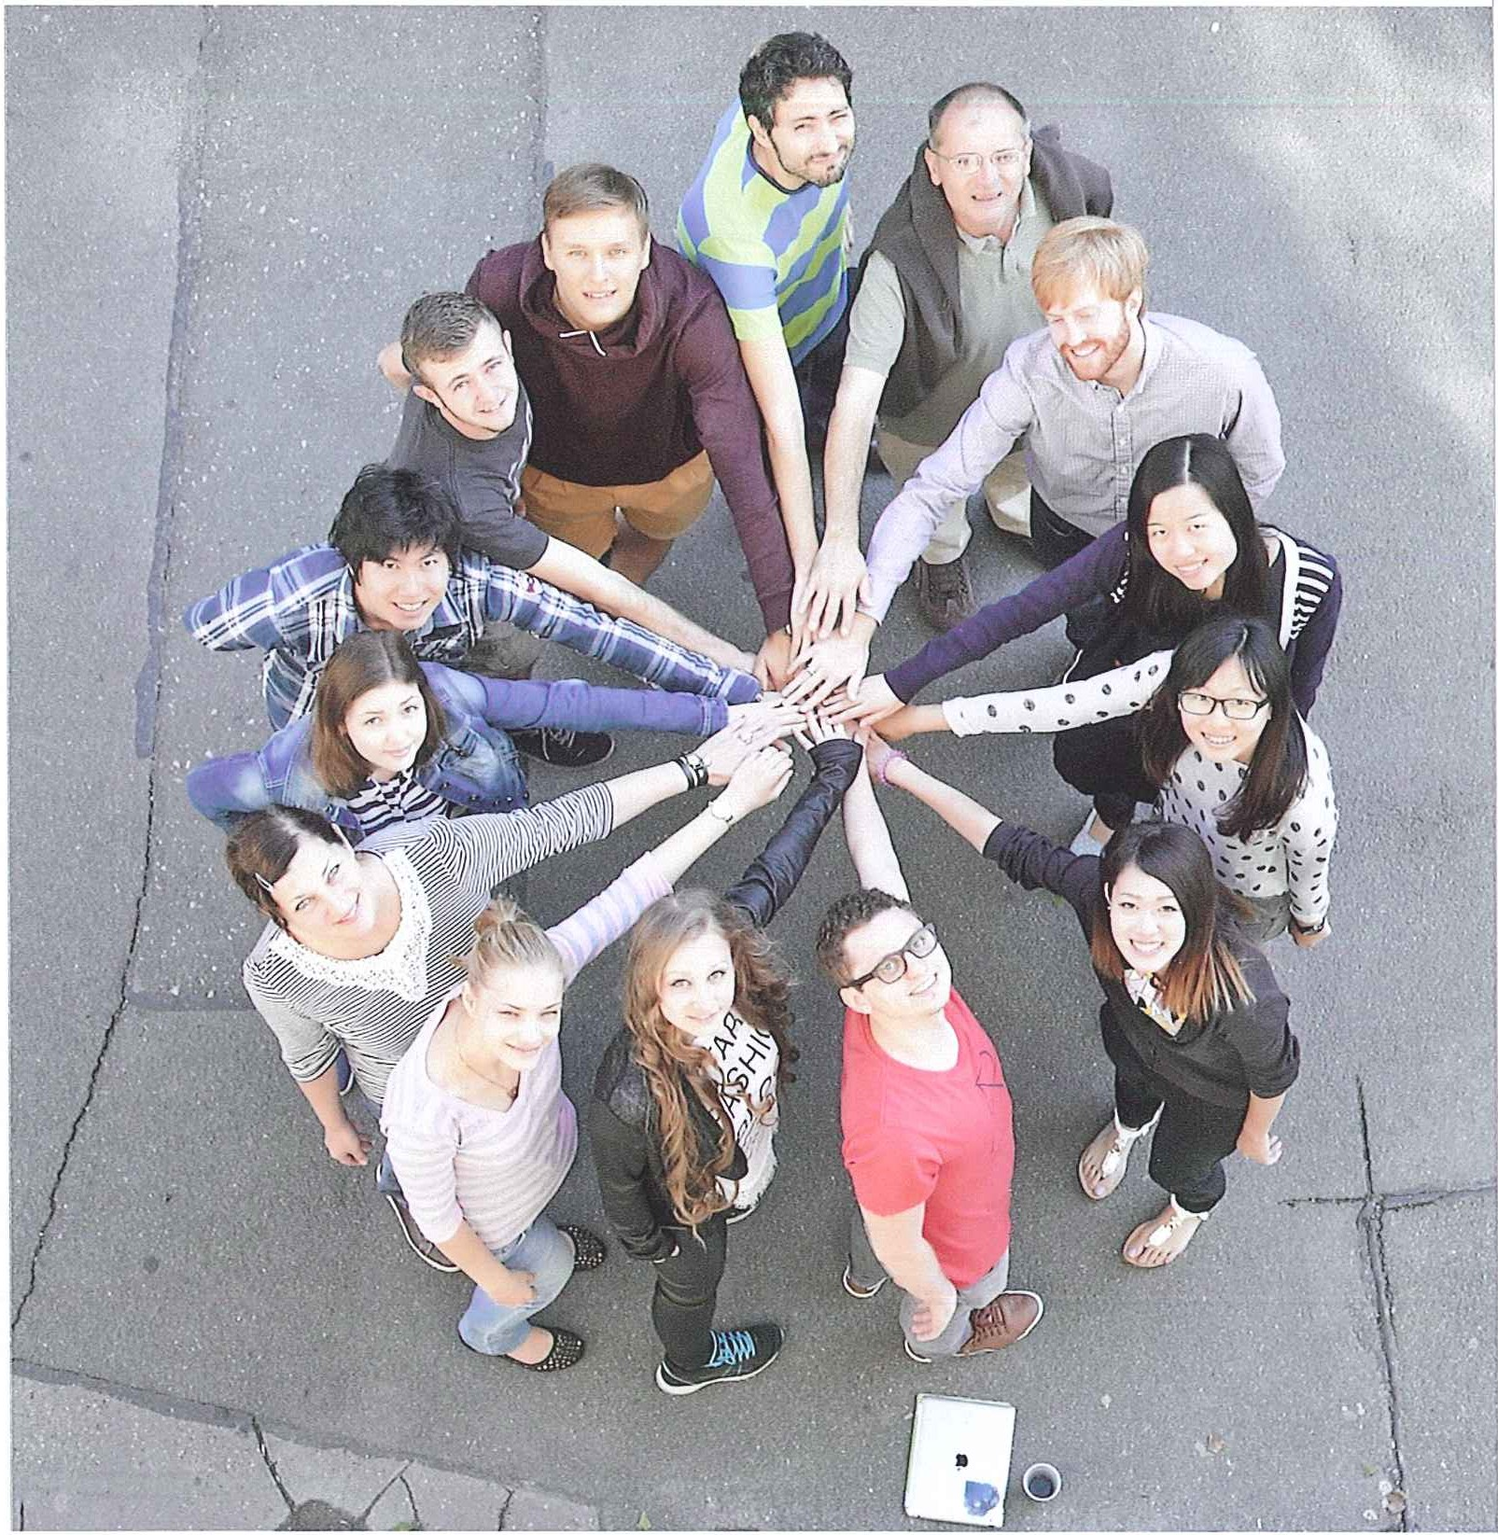
Summer in Austria and Germany
2024

Slide 2
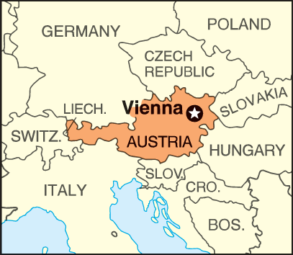
Universität Wien (Vienna)

Slide 3
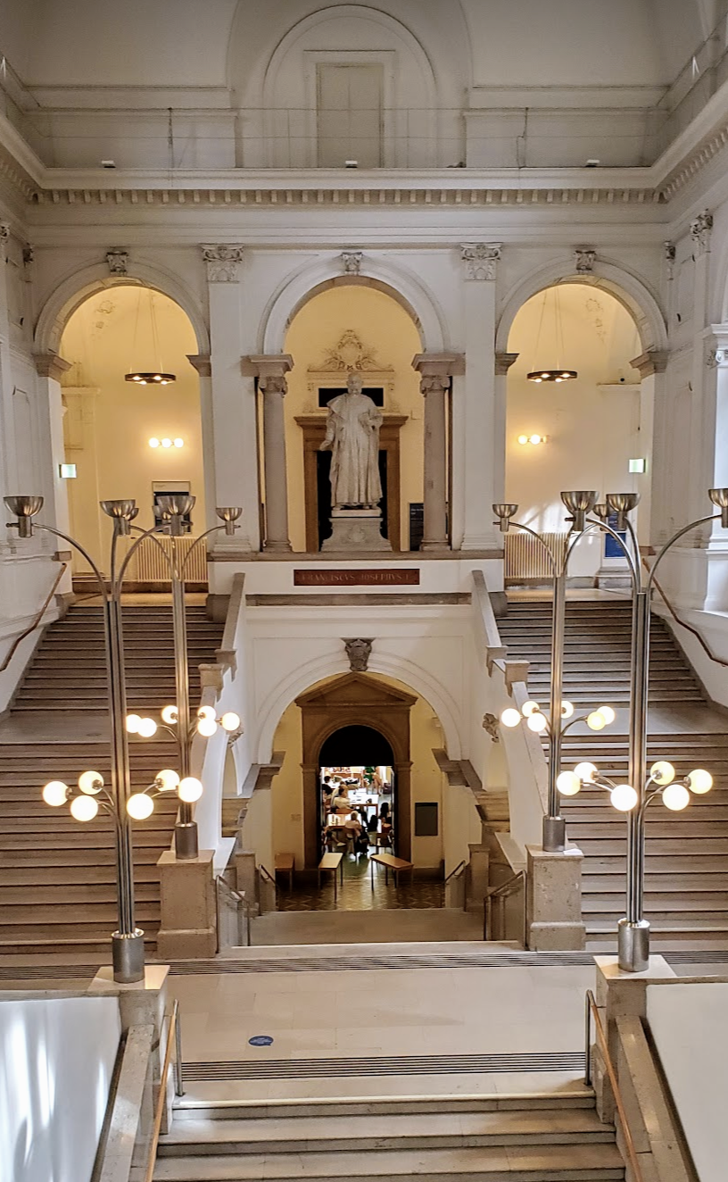
Universität Wien (Vienna)
(I) 08.07.2024 - 02.08.2024; (II) 05.08.2024 - 30.08.2024
3 credits
All levels
Course fee: € 600
Rooms: € 685 (single room) (already on waiting list for July session!)
Course link
Vienna: The most liveable city

Slide 4
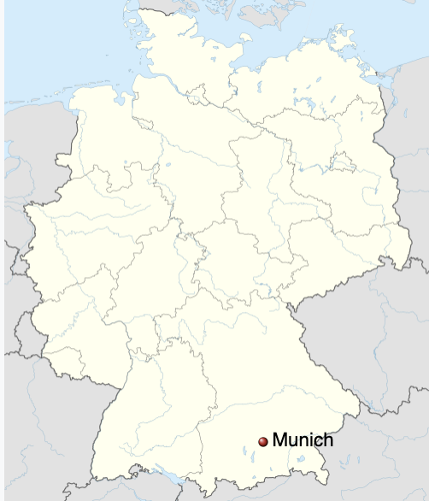
München (Munich)

Slide 5
Universität München
5 - 29 August, 2024
All levels
3 credits
Course fee: €500 + € 150 Registration
Accommodation: Book your own (rooms fully booked as of 25.1.24!)
https://www.ssk-misu.de/en/

Slide 6
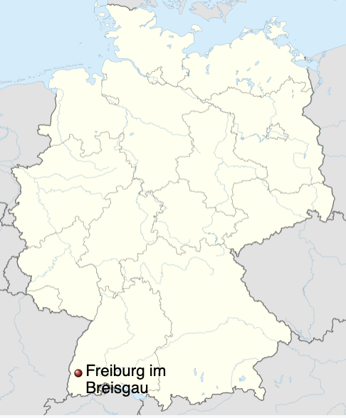
Freiburg

Slide 7
Freiburg
2 - 29 August 2024
all levels
3 credits
Course fee: €880
Accommodation: €470
https://www.sli.uni-freiburg.de/german/intensive/summer-winter/august-en24

Slide 8
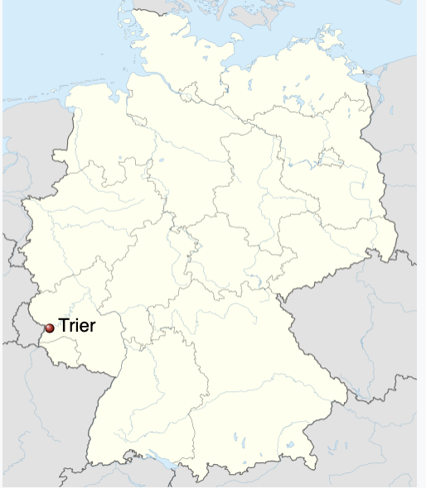
Trier

Slide 9
Trier
5. -31.August 2024
all levels
3 credits
Course fee: €750
Accommodation: ~€400
https://www.uni-trier.de/en/international/coming-to-trier/international-summer-school
https://www.youtube.com/watch?v=K2n5RRe4Q6s

Slide 10
Heidelberg

Slide 11
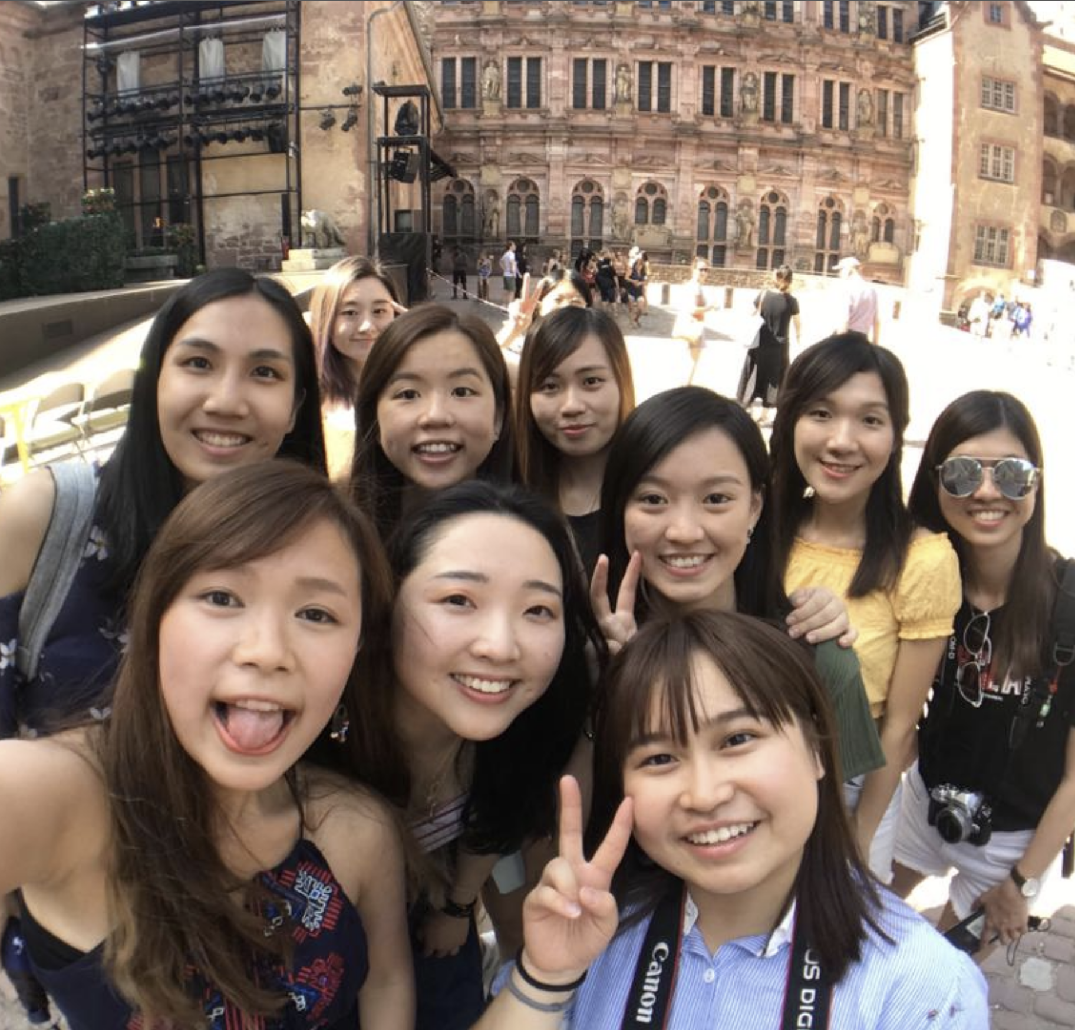
Universität Heidelberg
3 to August 30, 2024
Transfer 3 credits
All levels
Course fee: €820
Rooms: single room € 400 to 450
Registration: ASAP https://www.zuv.uni-heidelberg.de/international/ferienkurs/
Movie about Heidelberg
Is your college Shaw? Join them!

Slide 12
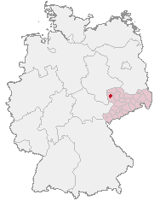
Leipzig

Slide 13
Universität Leipzig
Course A | 3rd June - 28th June
Course B | 1st July - 26th July
Course A | 7th August - 1st September - fully booked
3 credits
All levels
Course fee including accommodation: €1,025
Places are limited!!! Contact your teacher if you want to go to Leipzig
http://www.interdaf.uni-leipzig.de/summer-language-course.html

Slide 14
Berlin

Slide 15
Humboldt-Universität zu Berlin
17 June - 12 July 2024
15 July - 9 August 2024
3 weeks, 45 hours of language teaching, 3 times a week
Levels: A1-B2
Course fee: €690
Organize your own accommodation
https://hic.hu-berlin.de/en/huwisu/courses/summer

Slide 16
Example

Slide 17
Summary
Wien | München | Freiburg | Trier | Heidelberg | Leipzig | Berlin
July/ August | August | August | August | August | June, July | June, July
4 weeks | 4 weeks | 4 weeks | 4 weeks | 4 weeks | 4 weeks | 3 weeks
€1285 | €650 | €1350 | €1150 | €1250 | €1025 | €690
incl. accom. | no accom. | incl. accom. | incl. accom. | incl. accom. | incl. accom. | no accom.
Course info DAAD

Slide 18
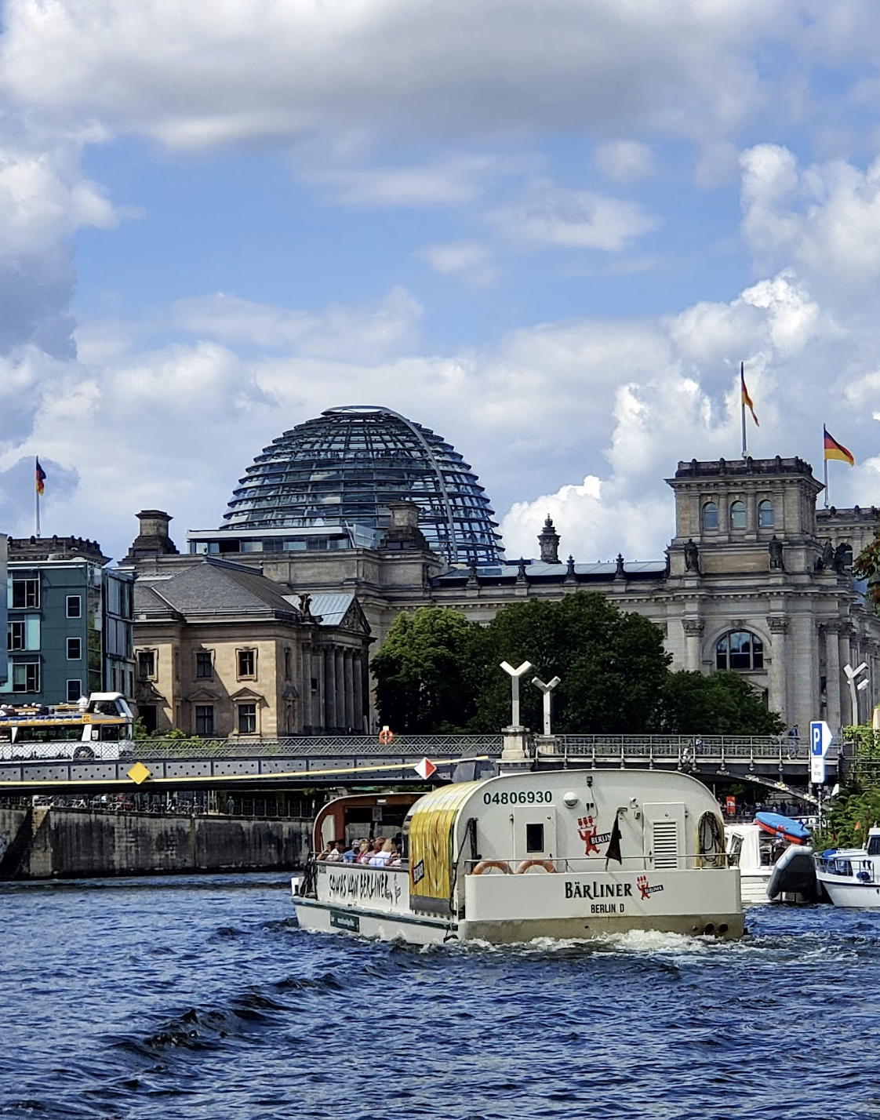
Enrolment
Read the Overseas Summer program notes
Find your favorite summer course on the DAAD Website
Register for your course online
Buy your air ticket and apply for visa if needed in Hong Kong!
Fill in the Financial Support Form online
Submit your certificate for credit transfer

Slide 19
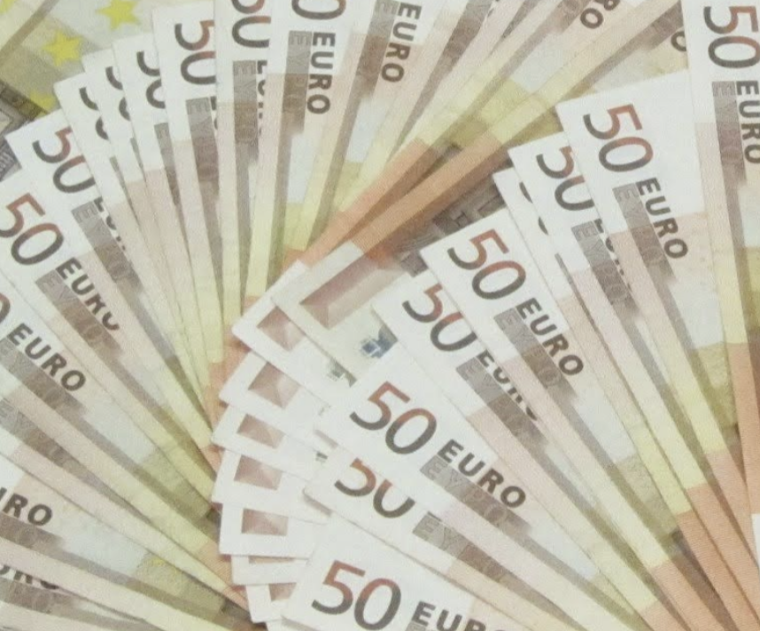
Funding
For college sponsorships, please contact your college.
The Department of Linguistics and Modern Languages will offer 5 awards of HK$5,000 (only non-final year Linguistics Major students).
Summer Subsistence and Travel Grant / Loan Scheme (OAFA), Enquiry 3943 1898 and 3943 7205

Slide 20
Note on Credit transfer:
Revise your German before leaving
Take the right level!
There is no 100% guarantee for credit transfer
Have fun, with or without credit transfer!

Slide 21
Final Year Students
For any loan/scholarship, you must still be enrolled at CUHK during the time of your summer course.
You will be eligible for financial aid for courses up to end July

Slide 22
NOTES ON DAAD Scholarship 2025
Scholarship from the German Academic Exchange Service (DAAD) for Summer 2025 of approx. EUR1800
Pass the “Goethe Zertifikat –A2” test (after German V)
Contact us in October 2024
Application deadline Nov 30 2024

Slide 23
DANKE!

